Slide 1
Bioinformatics pipeline development
Sailendra Pradhananga

Slide 2
A NGS Bioinformatician toolkit
Essential skill set
Operating System → Unix/Linux and Bash
Progamming → Python/Perl , C/C++/Java, R
Package and Environment Manager → Conda/mamba
Workflow Manager → Snakemake/Nextflow
Automated reports →Rmarkdown
Notebook → Jupyter lab or Jupyter notebook
Containers → Singularity/Docker)
Cluster and Cloud
Version control → Git

Slide 3

Command line interface (CLI) and scripting
Most popular unix shell is bash and basic implementation
Lingua franca
Can be changed together to make complex manipulation
Tutorial : https://swcarpentry.github.io/shell-novice/01-intro/index.html

Slide 4

Package and environment manager
Package, dependency and environment manager
Any program (python, snakemake, and hundreds of …)
Solves dependencies and environment

Slide 5
Install now !!!
https://docs.conda.io/projects/conda/en/latest/user-guide/install/index.html

Slide 6
Conda concepts
Channels
Bioconda
Conda-forge
Various condas
Anaconda -> big one, have 7500 open source package
Miniconda -> most essential one to get started
I suggest Miniconda

Slide 7
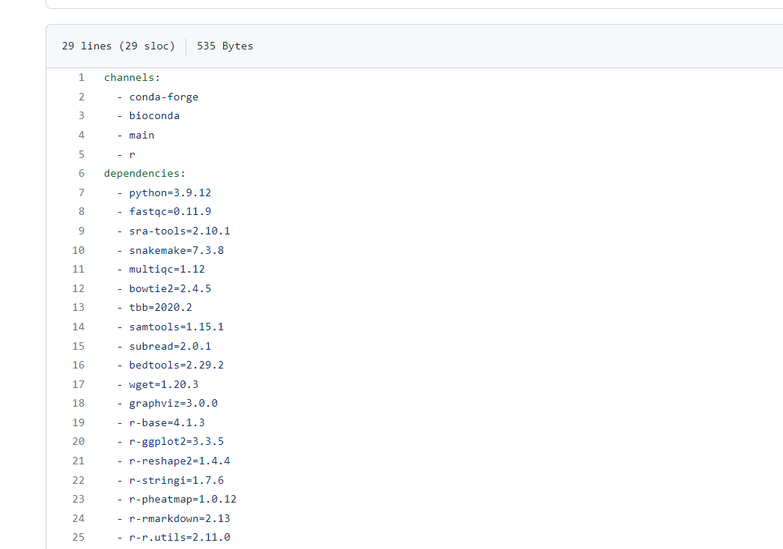
Defining and sharing environments
Via YML file
Ex:- from our repo , enviroment.yml

Slide 8
Basic operation example
Cheat code
https://docs.conda.io/projects/conda/en/4.6.0/_downloads/52a95608c49671267e40c689e0bc00ca/conda-cheatsheet.pdf
Find out how you create a new environment
How do call that environment
Update the environment
Activate and deactivate environment

Slide 9


Making workflow/pipelines
Two main players
Snakemake based on python
Nextflow based on groovy
Nextflow is what I use most and prolly most bioinformatician
But we learn snakemake here but let me know if nextflow interest you.

Slide 10
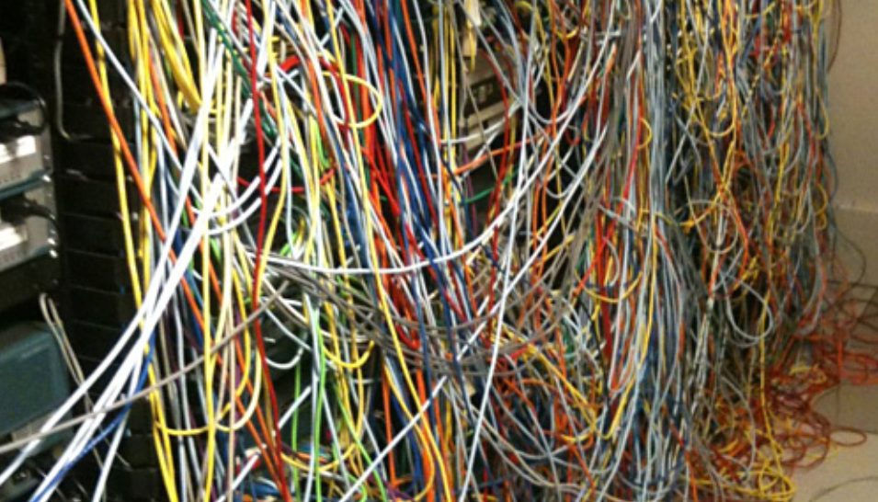

Why workflow manager
Sometime life is easier when we know how things fit together

Slide 11
Snakemake workflow
Tracks output/input file dependencies
Built from rules
Generalized with wildcards
Python grammar syntax
Scale up in cluster and cloud

Slide 12
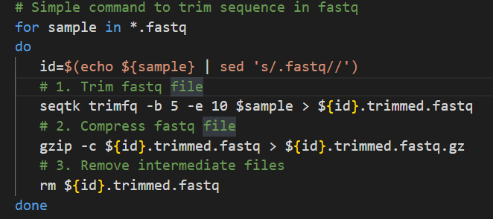
Example:
Bash script

Slide 13
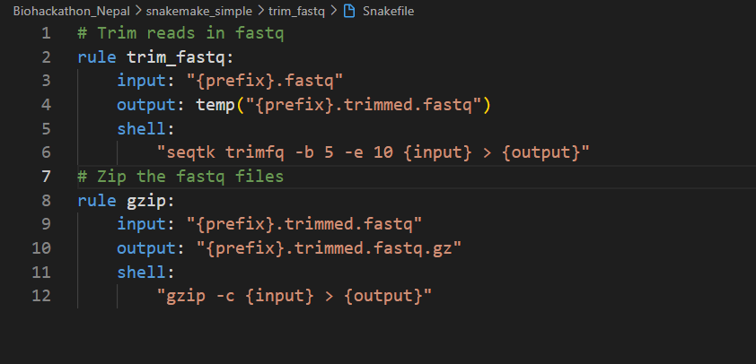
Snakemake rules
Rules → placeholders(input and output) and wildcards (prefix here but can be anything)
Based on output of the target it matches the rule and replacing the wildcard
Now in shell part the values are based on chosen wildcards
Errors are reported if conditions are not fullfilled

Slide 14
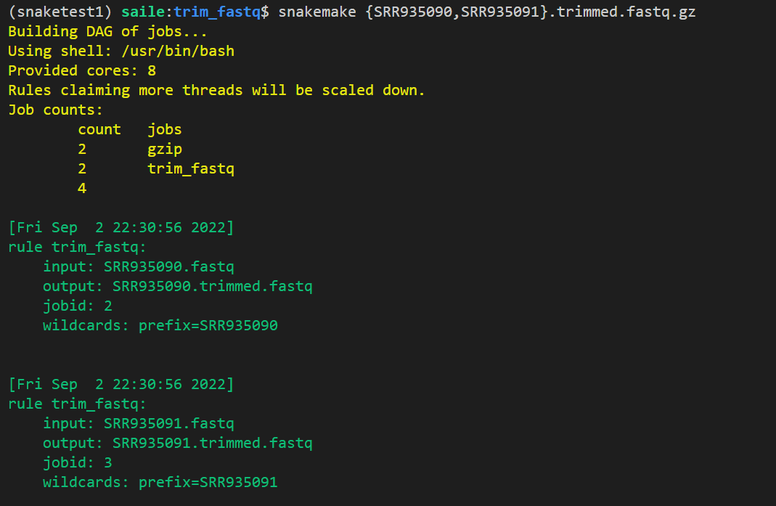
Running snakemake
Notes:
Define rules for all the processing steps
Choose input and output naming patterns that allow Snakemake to link the rules
Tell Snakemake to generate the final output files

Slide 15
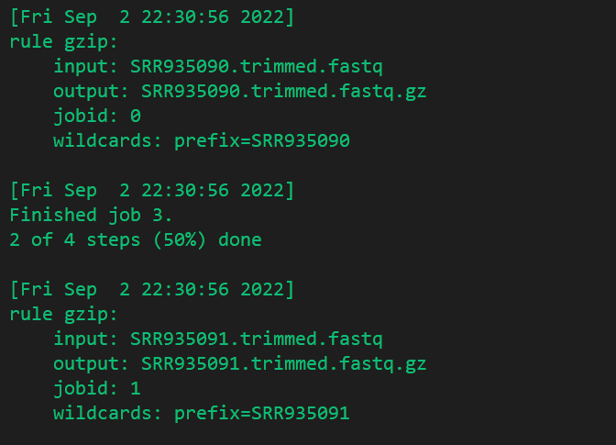
Running snakemake

Slide 16
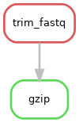
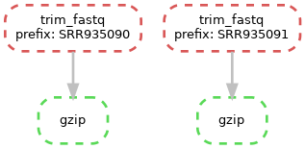
Visualization : rule graph

Slide 17
Visualiztion: Job graph

Slide 18
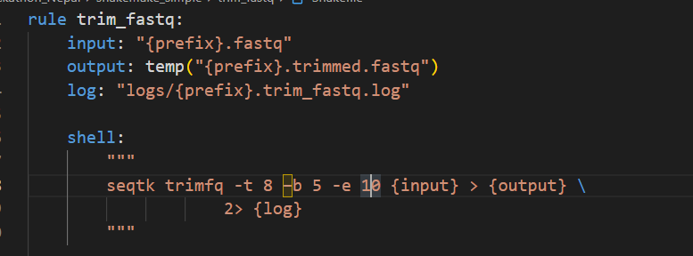
Snakemake logging outfiles

Slide 19
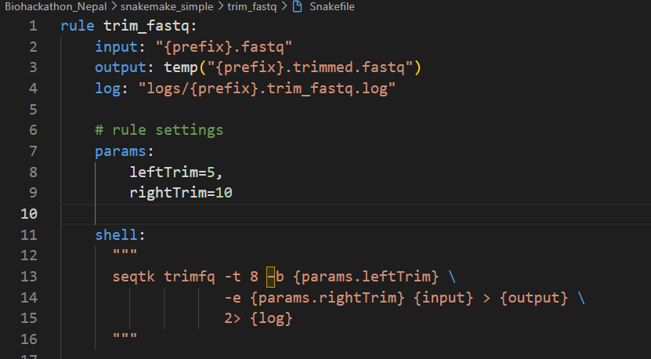
Snakemake: Adding params

Slide 20
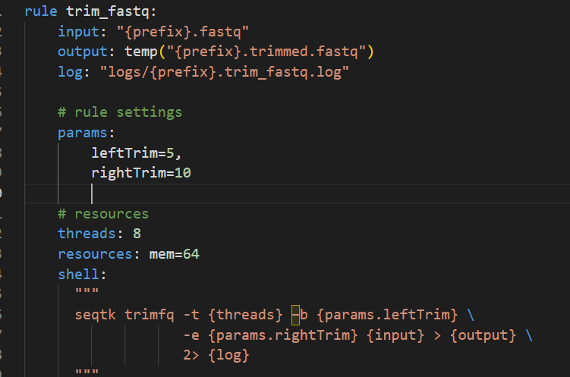
Snakemake: Adding resource info

Slide 21
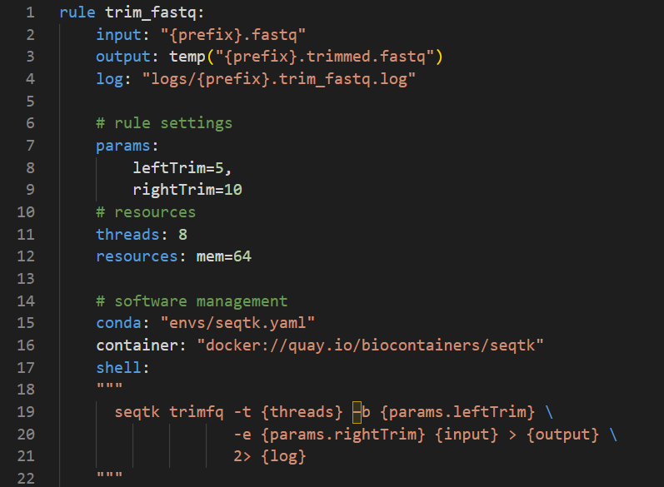
Snakemake: Adding environment information

Slide 22
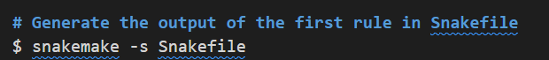
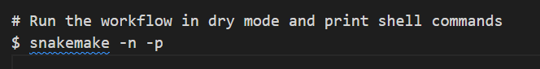
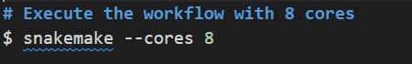
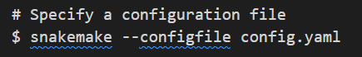
Snakemake commandline

Slide 23
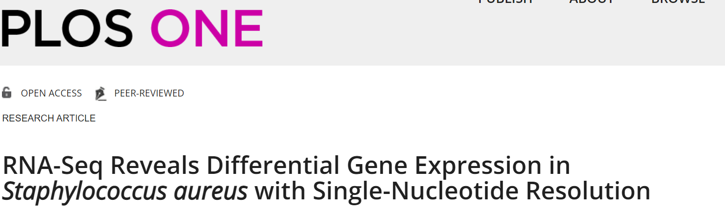
Case study
https://journals.plos.org/plosone/article?id=10.1371/journal.pone.0076572

Slide 24
See more on github
Biological question:
Studied methicillin-resistant Staphylococcus aureus (MRSA)
Lytic bactreiophages as potential therapeutic agent
Gp67 was identified as transciption factor with antimicrobial activity
To identify S. aureus genes repressed by gp67, the authors expressed gp67 in S. aureus cells. RNA-seq was then performed on three S. aureus strains:
RN4220 with pRMC2 with gp67
RN4220 with empty pRMC2
NCTC8325-4

Slide 25
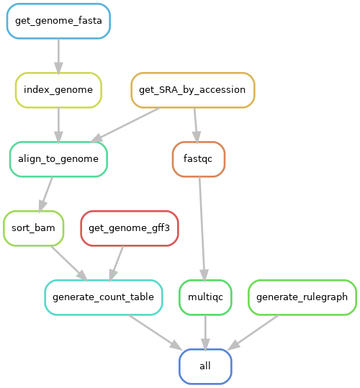
Running the snakemake

